Slide 1
Kentucky District 3 Warren County
Club Meeting – 2026.09.03

Slide 2
Agenda
Operations Update
🟢Operations Plan (Link)
🟢 Field Resources Manual (Link)
🟡 Field Operating Guide (Link)
Results of 8/29 Field Exercise
Portable antenna used for NCS
Summary of Discussion with Emergency Management
Weekly net NCS rotation
Nationwide ARRL Simulated Emergency Test
Future:
Desired cadence for meetings
Desired cadence for Exercises

Slide 3
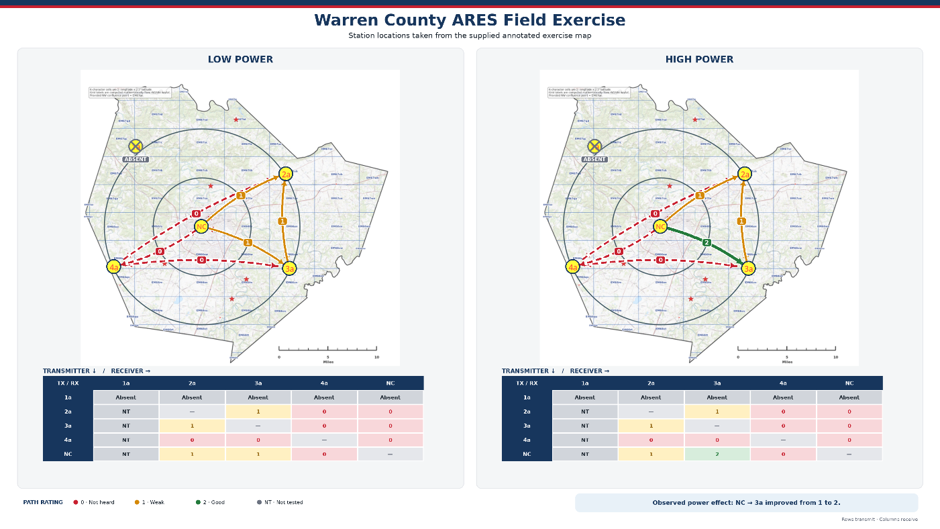
Field Exercise 20260829

Slide 4
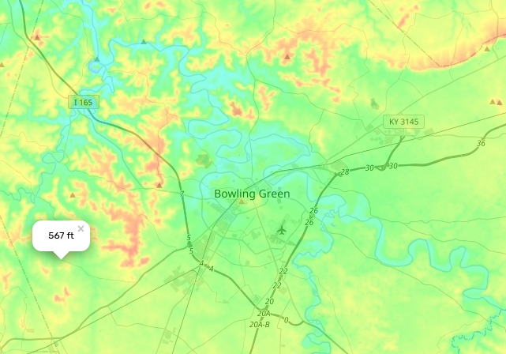
No wonder we couldn’t hear KD9GRD
This is good information! We need to know what obstacles to plan for and what capabilities we actually have.

Slide 5
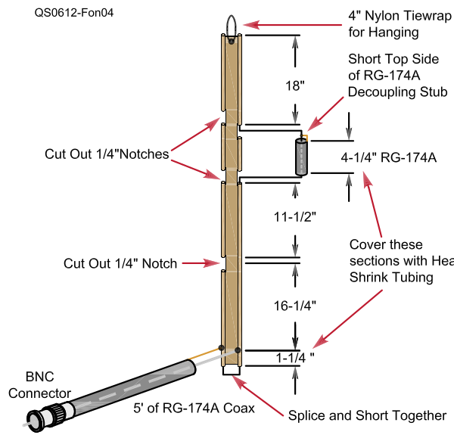
Dual Band Roll Up Antenna
Rubber Duckies often have negative dBi
Ed Fong WB6IQN Design
Replace 4-1/4” of RG-174A with 5” of RG8X with 5” cut in ladder line to match
A good chunk of shrink wrap (red box) over the Coax going to radio will secure it to the ladder line and join the stub and ladder line together

Slide 6
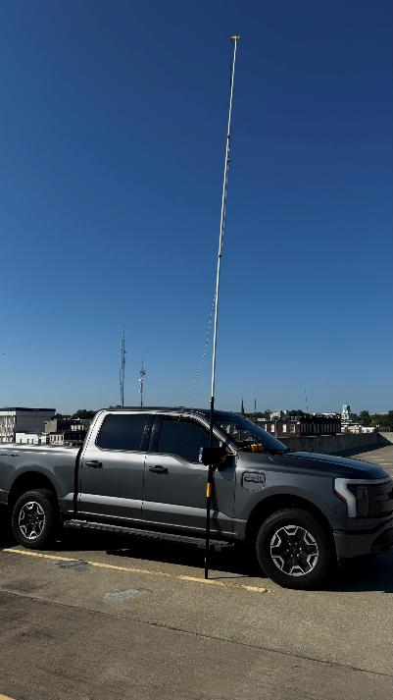
Mobile Setup Roll Up Antenna
NCS for Field Exercise
Dual Band roll up antenna on 20-25 foot of extendable painter’s pole
Passed coax through window to HT
Parked on top floor of parking structure in Downtown BG

Slide 7
Warren County EM Discussions
KY4JPS introduced me to the Director of Public Safety Bill Rector and Deputy Director of WCEM Kevin Bailey. On 8/14, Pat and myself met with Kevin (Bill not able to attend due to family emergency).
I introduced our group, its mission and priorities, and we discussed how ARES can help with their goals. It was a high-level meeting, and I expect it to be the first of many.
He did mention that there will be a statewide, all first responders SET, in the spring of 2027, something they do every 5 years.
He specifically mentioned Winlink and other digital modes, so please start learning about those.

Slide 8
Net Rotation

Slide 9
ARRL Simulated Emergency Test (SET)
10/3-10/4
Will be a surprise time and event
Working with SEC to verify state participation plans
Do we want to participate, even if it means making our own?
https://www.arrl.org/simulated-emergency-test?utm_source=Informz&utm_medium=Email&utm_campaign=ARRL&_zs=pgaDm&_zl=J2tq3

Slide 10
NWS Spotter Training
The National Weather Service offers spotter (SKYWARN) training and certification on a regular basis
You can sign up and take the classes online at https://www.weather.gov/pah/spottertraining or https://www.weather.gov/lmk/skywarn
Paducah is offering Elite Spotter Training (Advanced Spotting) on 10/22/26 from 18:00-22:00, but you must be Basic certified before taking this one.
Class is offered as on-line webinar

Slide 11
Future Items
How often do you want to hold meetings?
How often do you want to do field exercises?
Is format of Net OK or do you want more tactical?
What else can I do for you?

